Slide 1


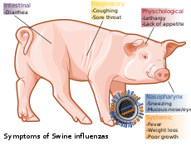
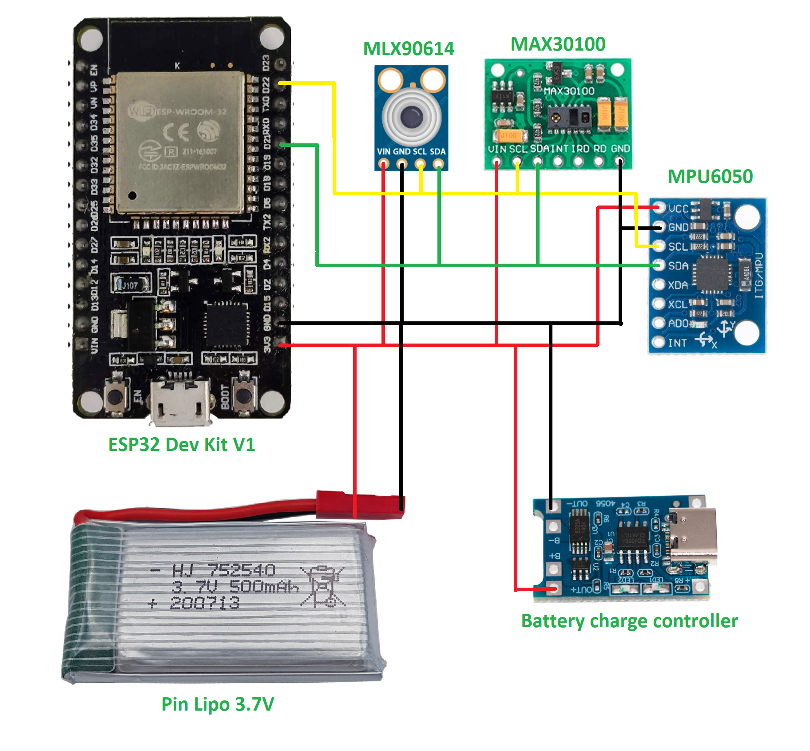
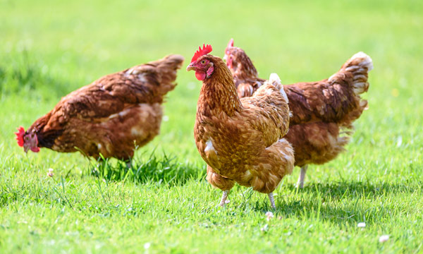
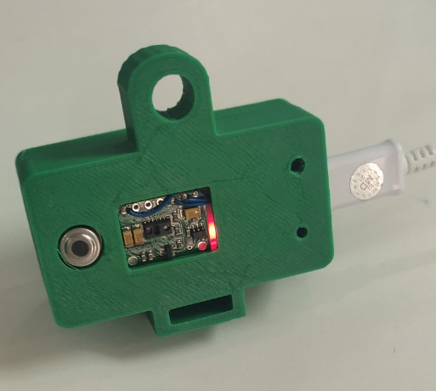
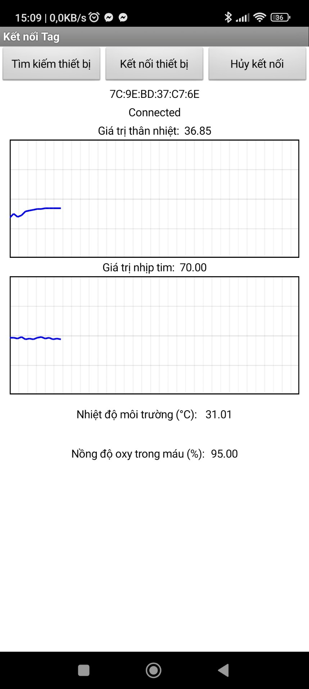
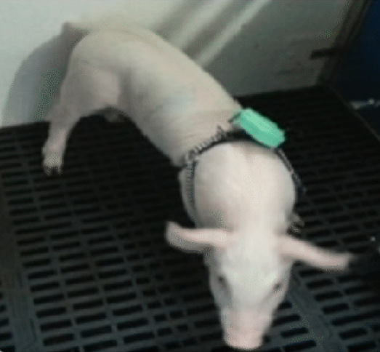

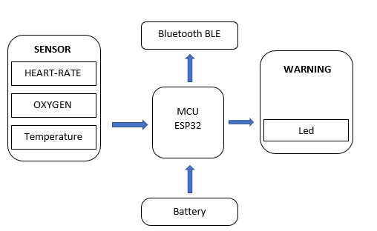
AI–JAM 2022
Project: ANIMAL HEALTH MONITORING DEVICE THROUGH BIOLOGICAL SENSOR
Author : Thi Minh Khue Doan, Lam Khai Trinh, Minh Hoang Tran, Trung Duc Luu, Phuc Thanh Nguyen, Nguyen Khai Minh Tran
I. Idea
IV. Components
V. Result
Bird flu, swine flu, swine dysentery have always been a threat to livestock and poultry’s health
It is challenging for farm caretaker to monitor the health and well-being status of all animals throughout the day in a continuous manner. .
It’s a simple, low-cost assistive device made from readily-available materials, and it can be built by anyone with a basic knowledge of electronics and IoT
Main controller of the device is an ESP32 devkitV1 using a 3.7V Lipo battery power supply with a battery charger circuit. The sensors of the device include: MLX90614 non-contact temperature sensor, MAX30100 heart rate sensor
VI. Innovation
II. Objectives
- Reads other data from the user such as: location, heart rate, blood oxygen concentration..
Create a simple and easily producible solution, an aid device for people with reduced vision: a bracelet that detects nearby objects and alerts the wearer to them.
- Warns the user about danger and potential threats
VII. Future improvements
III. Implementation process
Building app, web for remote monitoring
Equipment replication
Optimizing the price of equipment
BUILDING DIAGRAM AND SCHEMATIC
BUILD IN THE PCB BOARD
FINISHING AND TESTING DEVICE
Body temperature and heart rate/blood oxygen concentration from other sensors are uploaded to BLE data.
Developing predicting model
Industrial application

